Slide 1


Lecture7: Section 4.4
Nahid Majd, CSUSM
Computer Networking: A Top Down Approach
6th edition
Jim Kurose, Keith Ross
Addison-Wesley
March 2012
Classful IP addressing
Network Layer
4-<number>

Slide 2
Chapter 4: outline
4.1 introduction
4.2 virtual circuit and datagram networks
4.3 what’s inside a router
4.4 IP: Internet Protocol
  datagram format
  IPv4 addressing
  ICMP
  IPv6
4.5 routing algorithms
  link state
  distance vector
  hierarchical routing
4.6 routing in the Internet
  RIP
  OSPF
  BGP
4.7 broadcast and multicast routing
Network Layer
4-<number>

Slide 3


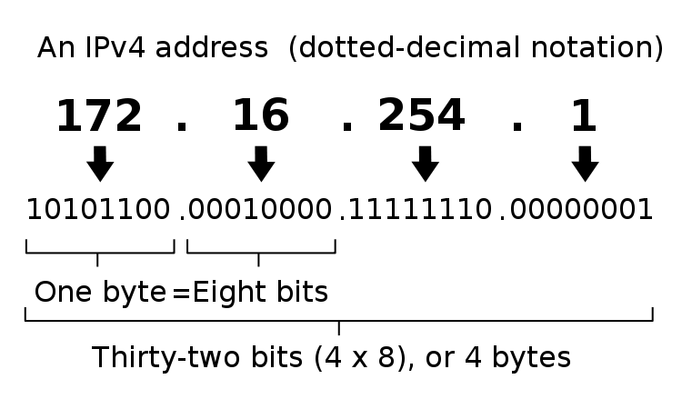





IP address
IP address: 32-bit identifier for host or router interface.
Note: Switch or Access point ports do NOT associate with IP addresses.
223.1.1.1
223.1.1.4
223.1.1.3
Switch
Router
223.1.2.7
223.1.2.1
223.1.2.3
Access Point
https://en.wikipedia.org/wiki/IP_address
Network Layer
4-<number>

Slide 4
8 bits: binary to decimal
0 | 0 | 0 | 0 | 0 | 0 | 0 | 0 | 0
0 | 0 | 0 | 0 | 0 | 0 | 0 | 1 | 1
0 | 0 | 0 | 0 | 0 | 0 | 1 | 0 | 2
0 | 0 | 0 | 0 | 0 | 0 | 1 | 1 | 3
0 | 0 | 0 | 0 | 0 | 1 | 0 | 0 | 4
0 | 0 | 0 | 0 | 0 | 1 | 0 | 1 | 5
0 | 0 | 0 | 0 | 0 | 1 | 1 | 0 | 6
0 | 0 | 0 | 0 | 0 | 1 | 1 | 1 | 7
0 | 0 | 0 | 0 | 1 | 0 | 0 | 0 | 8
0 | 0 | 0 | 0 | 1 | 0 | 0 | 1 | 9
0 | 0 | 0 | 0 | 1 | 0 | 1 | 0 | 10
0 | 0 | 0 | 0 | 1 | 0 | 1 | 1 | 11
0 | 0 | 0 | 0 | 1 | 1 | 0 | 0 | 12
0 | 0 | 0 | 0 | 1 | 1 | 0 | 1 | 13
0 | 0 | 0 | 0 | 1 | 1 | 1 | 0 | 14
0 | 0 | 0 | 0 | 1 | 1 | 1 | 1 | 15
. | . | . | . | . | . | . | . | .
. | . | . | . | . | . | . | . | .
. | . | . | . | . | . | . | . | .
1 | 1 | 1 | 1 | 1 | 0 | 0 | 0 | 248
1 | 1 | 1 | 1 | 1 | 0 | 0 | 1 | 249
1 | 1 | 1 | 1 | 1 | 0 | 1 | 0 | 250
1 | 1 | 1 | 1 | 1 | 0 | 1 | 1 | 251
1 | 1 | 1 | 1 | 1 | 1 | 0 | 0 | 252
1 | 1 | 1 | 1 | 1 | 1 | 0 | 1 | 253
1 | 1 | 1 | 1 | 1 | 1 | 1 | 0 | 254
1 | 1 | 1 | 1 | 1 | 1 | 1 | 1 | 255
Network Layer
4-<number>

Slide 5
IP addressing: introduction
223.1.1.1
IP address: 32-bit identifier for host, router interface
interface: connection between host/router and physical link
  routers typically have multiple interfaces
  host typically has one or two interfaces (e.g., wired Ethernet, wireless 802.11)
IP addresses associated with each interface
223.1.2.1
223.1.1.2
223.1.1.4
223.1.2.9
223.1.1.3
223.1.3.27
223.1.2.2
223.1.3.1
223.1.3.2
223.1.1.1 = 11011111 00000001 00000001 00000001
223
1
1
1
Network Layer
4-<number>

Slide 6

IP addressing: introduction
223.1.1.1
Q: how are interfaces actually connected?
A: with a switch or AP
223.1.2.1
223.1.1.2
223.1.1.4
223.1.2.9
223.1.1.3
223.1.3.27
223.1.2.2
A: wired Ethernet interfaces connected by Ethernet switches
223.1.3.1
223.1.3.2
A: wireless WiFi interfaces connected by WiFi Access Point
Network Layer
4-<number>

Slide 7
How to find your IP address?
Windows
  ipconfig command
  Ctrl panel → adapter → Network and sharing center → View network connections → View status of this connection → Details
Linux or Mac
  ifconfig command → inet
  Mac: System preferences → Network → Advanced → TCP/IP
  Ubuntu: Network icon → Connection information
Network Layer
4-<number>

Slide 8
Subnets
subnet
what’s a subnet ?
  device interfaces that can physically reach each other without intervening router
recipe
to determine the subnets, detach each interface from its host or router, creating islands of isolated networks
each isolated network is called a subnet
subnet
223.1.1.1
223.1.1.2
223.1.2.1
223.1.1.4
223.1.2.9
223.1.2.2
223.1.1.3
223.1.3.27
subnet
223.1.3.1
223.1.3.2
network consisting of 3 subnets
Network Layer
4-<number>

Slide 9
Subnets
223.1.1.2
how many subnets?
223.1.1.1
223.1.1.4
223.1.1.3
223.1.9.2
223.1.7.0
223.1.9.1
223.1.7.1
223.1.8.1
223.1.8.0
223.1.2.6
223.1.3.27
223.1.2.1
223.1.2.2
223.1.3.1
223.1.3.2
Network Layer
4-<number>

Slide 10
Subnets
subnet
An IP address consists of
  Subnet part: high order bits
  Host part: low order bits
what’s a subnet ?
  device interfaces with same subnet part of IP address
IP addr: xxxxxx…xxxxxxx
subnet host
part part
subnet
223.1.1.1
223.1.1.2
223.1.2.1
223.1.1.4
223.1.2.9
223.1.2.2
223.1.1.3
223.1.3.27
subnet
223.1.3.1
223.1.3.2
network consisting of 3 subnets
Network Layer
4-<number>

Slide 11
Classful Network
Class A devices
  Network part: Share same first Byte (bits 0-7)
  Host part: second through fourth Bytes (bits 8-31)
Class B devices
  Network part: Share same first two Bytes (bits 0-15)
  Host part: third through fourth Bytes (bits 16-31)
Class C devices
  Network part: Share same first three Bytes (bits 0-23)
  Host part: fourth Byte (bits 24-31)
Network
Host
Host
Host
Network
Network
Host
Host
Network
Network
Network
Host
Network Layer
4-<number>

Slide 12
Classful Network (cont’d.)
Class D, Class E rarely used (never assign)
  Class D: value between 224 and 239
    Multicasting
  Class E: value between 240 and 254
    Experimental use
Network Layer
4-<number>

Slide 13
Classful Network (cont’d.)
Example
  Class C: 8 bits host part
Eight bits have 256 combinations: 0-255
  Hosts can use 1 through 254 (0 and 255 are reserved)
  0: reserved for Network ID
  255: reserved for broadcast transmission
  Example:
    200.10.212.0 would represent Network ID for hosts whose addresses start with 200.10.212
    200.10.212.255 would represent a broadcast to all hosts whose networks start with 200.10.212
    Range of valid addresses in this example:
    200.10.212.1 - 200.10.212.254
Network
Network
Network
Host
Network Layer
4-<number>

Slide 14
Dividing a range of numbers:
0 | 0 | 0 | 0 | 0
0 | 0 | 0 | 0 | 1
0 | 0 | 0 | 1 | 0
0 | 0 | 0 | 1 | 1
0 | 0 | 1 | 0 | 0
0 | 0 | 1 | 0 | 1
0 | 0 | 1 | 1 | 0
0 | 0 | 1 | 1 | 1
0 | 1 | 0 | 0 | 0
0 | 1 | 0 | 0 | 1
0 | 1 | 0 | 1 | 0
0 | 1 | 0 | 1 | 1
0 | 1 | 1 | 0 | 0
0 | 1 | 1 | 0 | 1
0 | 1 | 1 | 1 | 0
0 | 1 | 1 | 1 | 1
1 | 0 | 0 | 0 | 0
1 | 0 | 0 | 0 | 1
1 | 0 | 0 | 1 | 0
1 | 0 | 0 | 1 | 1
1 | 0 | 1 | 0 | 0
1 | 0 | 1 | 0 | 1
1 | 0 | 1 | 1 | 0
1 | 0 | 1 | 1 | 1
1 | 1 | 0 | 0 | 0
1 | 1 | 0 | 0 | 1
1 | 1 | 0 | 1 | 0
1 | 1 | 0 | 1 | 1
1 | 1 | 1 | 0 | 0
1 | 1 | 1 | 0 | 1
1 | 1 | 1 | 1 | 0
1 | 1 | 1 | 1 | 1
0 | 0 | 0 | 0 | 0
0 | 0 | 0 | 0 | 1
0 | 0 | 0 | 1 | 0
0 | 0 | 0 | 1 | 1
0 | 0 | 1 | 0 | 0
0 | 0 | 1 | 0 | 1
0 | 0 | 1 | 1 | 0
0 | 0 | 1 | 1 | 1
0 | 1 | 0 | 0 | 0
0 | 1 | 0 | 0 | 1
0 | 1 | 0 | 1 | 0
0 | 1 | 0 | 1 | 1
0 | 1 | 1 | 0 | 0
0 | 1 | 1 | 0 | 1
0 | 1 | 1 | 1 | 0
0 | 1 | 1 | 1 | 1
1 | 0 | 0 | 0 | 0
1 | 0 | 0 | 0 | 1
1 | 0 | 0 | 1 | 0
1 | 0 | 0 | 1 | 1
1 | 0 | 1 | 0 | 0
1 | 0 | 1 | 0 | 1
1 | 0 | 1 | 1 | 0
1 | 0 | 1 | 1 | 1
1 | 1 | 0 | 0 | 0
1 | 1 | 0 | 0 | 1
1 | 1 | 0 | 1 | 0
1 | 1 | 0 | 1 | 1
1 | 1 | 1 | 0 | 0
1 | 1 | 1 | 0 | 1
1 | 1 | 1 | 1 | 0
1 | 1 | 1 | 1 | 1
0 | 0 | 0 | 0 | 0
0 | 0 | 0 | 0 | 1
0 | 0 | 0 | 1 | 0
0 | 0 | 0 | 1 | 1
0 | 0 | 1 | 0 | 0
0 | 0 | 1 | 0 | 1
0 | 0 | 1 | 1 | 0
0 | 0 | 1 | 1 | 1
0 | 1 | 0 | 0 | 0
0 | 1 | 0 | 0 | 1
0 | 1 | 0 | 1 | 0
0 | 1 | 0 | 1 | 1
0 | 1 | 1 | 0 | 0
0 | 1 | 1 | 0 | 1
0 | 1 | 1 | 1 | 0
0 | 1 | 1 | 1 | 1
0 | 0 | 0 | 0 | 0
0 | 0 | 0 | 0 | 1
0 | 0 | 0 | 1 | 0
0 | 0 | 0 | 1 | 1
0 | 0 | 1 | 0 | 0
0 | 0 | 1 | 0 | 1
0 | 0 | 1 | 1 | 0
0 | 0 | 1 | 1 | 1
0 | 1 | 0 | 0 | 0
0 | 1 | 0 | 0 | 1
0 | 1 | 0 | 1 | 0
0 | 1 | 0 | 1 | 1
0 | 1 | 1 | 0 | 0
0 | 1 | 1 | 0 | 1
0 | 1 | 1 | 1 | 0
0 | 1 | 1 | 1 | 1
0 - 15
0 - 15
0 - 15
0 - 31
1 | 0 | 0 | 0 | 0
1 | 0 | 0 | 0 | 1
1 | 0 | 0 | 1 | 0
1 | 0 | 0 | 1 | 1
1 | 0 | 1 | 0 | 0
1 | 0 | 1 | 0 | 1
1 | 0 | 1 | 1 | 0
1 | 0 | 1 | 1 | 1
1 | 1 | 0 | 0 | 0
1 | 1 | 0 | 0 | 1
1 | 1 | 0 | 1 | 0
1 | 1 | 0 | 1 | 1
1 | 1 | 1 | 0 | 0
1 | 1 | 1 | 0 | 1
1 | 1 | 1 | 1 | 0
1 | 1 | 1 | 1 | 1
1 | 0 | 0 | 0 | 0
1 | 0 | 0 | 0 | 1
1 | 0 | 0 | 1 | 0
1 | 0 | 0 | 1 | 1
1 | 0 | 1 | 0 | 0
1 | 0 | 1 | 0 | 1
1 | 0 | 1 | 1 | 0
1 | 0 | 1 | 1 | 1
1 | 1 | 0 | 0 | 0
1 | 1 | 0 | 0 | 1
1 | 1 | 0 | 1 | 0
1 | 1 | 0 | 1 | 1
1 | 1 | 1 | 0 | 0
1 | 1 | 1 | 0 | 1
1 | 1 | 1 | 1 | 0
1 | 1 | 1 | 1 | 1
16 - 23
16 - 23
16 - 31
24 - 27
24 - 31
28 - 31
Network Layer
4-<number>

Slide 15
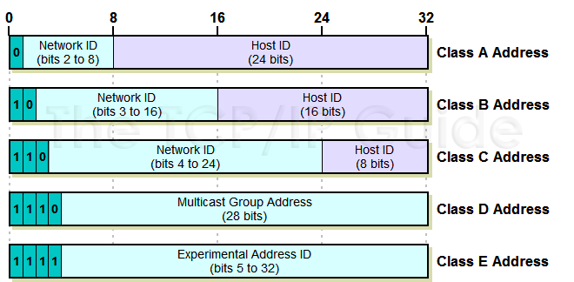
Classful IP addresses
Network Layer
4-<number>

Slide 16
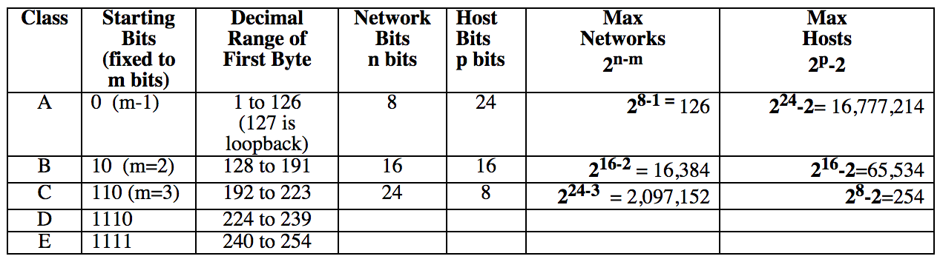
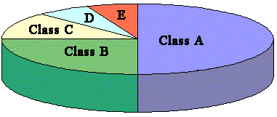
Classful IP addresses
There are a total of 2³² = 4,294,967,296 possible addresses.
The allocation of 4,294,967,296 Addresses
Network Layer
4-<number>

Slide 17
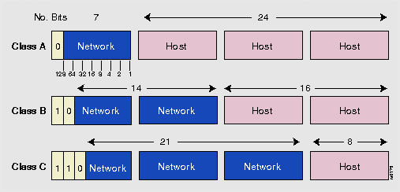
Classful IP addr
Class A: large subnets
  Network part (shared part): 1st Byte (bits 0-7)
  Host part (host identifier): 2nd, 3rd and 4th Bytes (bits 8-31)
Class B: Medium size subnets
  Network part (shared part): 1st and 2nd Bytes (bits 0-15)
  Host part (host identifier): 3rd and 4th Bytes (bits 16-31)
Class C: Small subnets
  Network part (shared part): 1st, 2nd and 3rd Bytes (bits 0-7)
  Host part (host identifier): 4th Byte (bits 8-31)
Network Layer
4-<number>

Slide 18
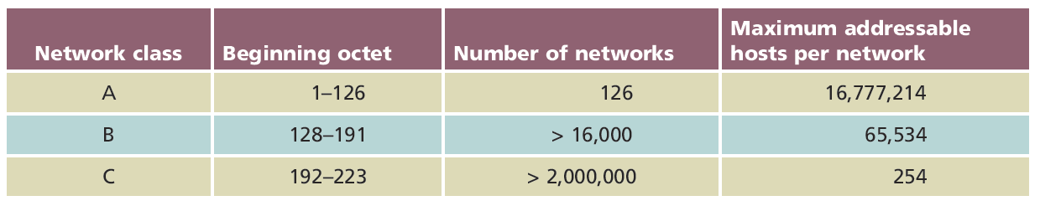
Number of networks in each class
Network Layer
4-<number>

Slide 19
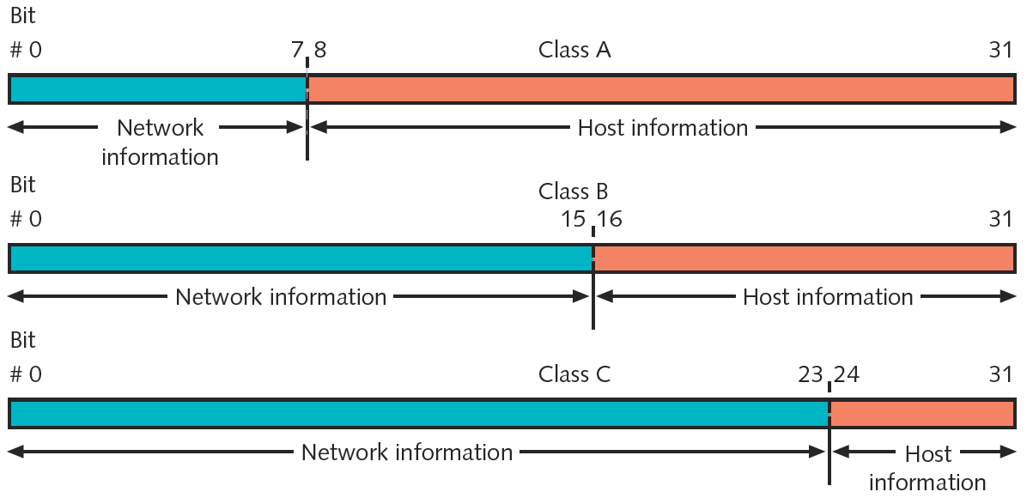
IPv4 addresses and their classes
Network Layer
4-<number>

Slide 20
Network ID
Different names used for Network ID:
  Net ID, Network Prefix, Network Address, Network Information
Identify the network segment within a larger network
All the systems that attach and share access to the same network have a common network ID within their full IP address.
This ID is also used to uniquely identify each network within the larger internetwork.
Network Layer
4-<number>

Slide 21
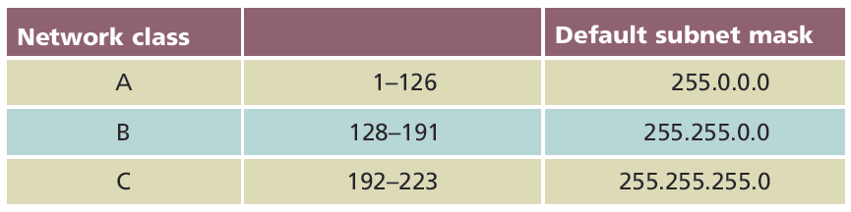
Subnet Mask
32-bit number identifying a device’s subnet
Combines with device IP address
Informs network about segment, network where device attached
Four Bytes (32 bits)
  Expressed in binary or dotted decimal notation
  1’s for Net part
  0’s for Host part
Assigned same way as IP addresses
  Manually or automatically (via DHCP)
Network Layer
4-<number>

Slide 22

Subnet Mask (cont’d.)
Class A:
Class B:
Class C:
11111111
00000000
00000000
00000000
11111111
11111111
00000000
00000000
11111111
11111111
11111111
00000000
Network Layer
4-<number>

Slide 23
Valid Addresses on subnet
Cannot use the first and last address on a subnet. These are reserved addresses.
  “All 0’s” or “All 1’s” in host part
  Network ID: Lower bound (all 0’s)
  Broadcast IP: Upper bound (all 1’s)
Example:
NetID = IP addr & Subnet mask
Class | Subnet mask | some valid IP | Net ID | Broadcast IP
A | 255.0.0.0 | 10.26.54.8 | 10.0.0.0 | 10.255.255.255
B | 255.255.0.0 | 172.16.20.0 | 172.16.0.0 | 172.16.255.255
C | 255.255.255.0 | 192.168.27.38 | 192.168.27.0 | 192.168.27.255
Network Layer
4-<number>

Slide 24
Subnet mask
In networking, a subnet mask is used to calculate what hosts can be reached.
IP address - 192.168.1.123
Mask - 255.255.255.0
192.168.1.123 can communicate to any host in the range 192.168.1.1 to 192.168.1.254
This network is called a subnet. Also referred to as a broadcast domain. Host can only communicate with machines within its broadcast domain. Host outside of the broadcast domain cannot be reached directly.
Network Layer
4-<number>

Slide 25
Examples
Class C
IP addr instance | 192.168.110.67
Subnet mask | 255.255.255.0
Network ID | 192.168.110.0
Bcast IP address | 192.168.110.255
Range of all IP addr in subnet
Range of valid IP addr in subnet
1st & last addr
are reserved.
Net ID
Net ID
Net ID
Host ID
Network Layer
4-<number>

Slide 26
Examples
Class B
IP addr instance | 172.16.10.39
Subnet mask
Network ID
Bcast IP address
Range of all IP addr in subnet
Range of valid IP addr in subnet
1st & last addr
are reserved.
Net ID
Net ID
Host ID
Host ID
Network Layer
4-<number>

Slide 27
Examples
Class A
IP addr instance | 10.20.135.12
Subnet mask
Network ID
Bcast IP address
Range of all IP addr in subnet
Range of valid IP addr in subnet
1st & last addr
are reserved.
Net ID
Host ID
Host ID
Host ID
Network Layer
4-<number>

Slide 28
Calculate Subnet Size
How is the size of a network determined?
Network Bits vs. Host Bits.
Network Layer
4-<number>

Slide 29
Calculate Subnet Size
2^{n} where n = number of host bits
  Class A: 8 bits Network part, 24 bits Host part
    Subnet size: 2²⁴-2 = 16,777,214
  Class B: 16 bits Network part, 16 bits Host part
    Subnet size: 2¹⁶-2 = 65,534
  Class C: 24 bits Network part, 8 bits Host part
    Subnet size: 2⁸ -2 = 254
Network Layer
4-<number>

Slide 30
Binary vs Dotted Decimal Notation
Dotted decimal notation
  Common way of expressing IP addresses
  Value of each Byte between 0 and 255
  Period (dot) separates each Byte
  Human Readable
Dotted decimal address has binary equivalent
  Computer converts each Byte to binary
Network Layer
4-<number>

Slide 31
Converting binary <-> decimal
http://www.wikihow.com/Convert-from-Binary-to-Decimal
http://www.wikihow.com/Convert-from-Decimal-to-Binary
Khan Academy tutorials
https://www.khanacademy.org/math/pre-algebra/applying-math-reasoning-topic/alternate-number-bases/v/decimal-to-binary
https://www.khanacademy.org/math/pre-algebra/applying-math-reasoning-topic/alternate-number-bases/v/large-number-decimal-to-binary
https://bryce.fisher-fleig.org/blog/the-missing-guide-to-subnet-masks/
Network Layer
4-<number>

Slide 32
Number Systems
Any number can be represented by different number systems
12 in base 10 = 1 * 10¹ + 2*10⁰ = 10+2 = 12 (base 10)
12 in base 8 = 1*8¹ + 2*8⁰ = 8+2 = 10 (base 10)
12 in base 16 (hex) =1*16¹ + 2*16⁰ = 16+2 = 18 (base 10)
“12” in base 2 (binary) is not possible. Only values of 0 and 1.
12 base 10 represented in base 2:
  1*2³ + 1*2² + 0*2⁰ = 8 + 4 + 0 => 12 base 10 = 110 base 2
Network Layer
4-<number>

Slide 33
Converting Decimal to Binary
Use powers of 2, i.e.
  2⁷ = 128
  2⁶ = 64
  …
  2⁰ = 1
255 = 128+64+32+16+4+2+1 or 11111111
240 = 128+64+32+16+0+0+0 or 11110000
128 = 128+ 0+ 0+ 0+0+0+0 or 10000000
64 = 0+64+ 0+ 0+0+0+0 or 01000000
Network Layer
4-<number>

Slide 34
Loopback address
Loopback address:
  127.0.0.1
An address that sends outgoing signals back to the same computer for testing.
Pinging this address will always return a reply unless the firewall prevents it.
Network Layer
4-<number>

Slide 35
PING
Provides verification
  TCP/IP installed, bound to NIC, configured correctly, communicating with network
  Host responding
Ping IP address or host name
Network Layer
4-<number>

Slide 36
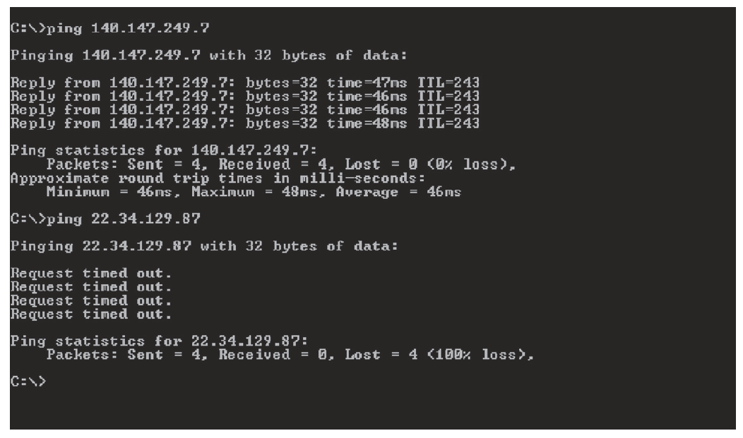
PING (cont’d.)
Operating system determines PING command options, switches, syntax
Output from successful and unsuccessful PING
Network Layer
4-<number>

